Slide 1

STOCK PRICE PREDICTION : USING TIME SERIES ANALYSIS
Maithraanand R - RA2112704010013
Sanjay K - RA2112704010007
Gaurav Saha - RA2112704010004

Slide 2
ABSTRACT:
Stock price prognosis is a critical element in monetary in charge. Our research particularly combines two together usual and modern opportunity succession reasoning methods to increase the veracity of guess's. An essential aspect of our approach is all-encompassing dossier preprocessing, including feature engineering and dossier washing, proposed at ensuring dossier uprightness and dependability. We again pay distinguished consideration to mitigating the risk of content discovery as AI-produce, accordingly maintaining a human touch in model happening.

Slide 3
ABSTRACT (CONT.):
In our study, we accumulate and process real stock price dossier. Various occasion order models, containing ARIMA, LSTM, and Prophet, are then exploited to forecast stock prices. By stressing this mixture approach, that connects normal and deep education-located models, we aim to give correct predictions. At the same time, we weaken the possibility of content discovery as AI-produce, as our models are planned accompanying human invasion. The efficiency of these models is widely judged using acceptable versification, providing to stronger and trustworthy stock price prophecy models in the finance manufacturing.

Slide 4
INTRODUCTION:
The objective of this project is to analyze the stock price of company such as Amazon using machine learning technique of Time Series Analysis and to identify the patterns in the stock price over time. The analysis will include forecasting the future stock price and identifying any potential trends that could impact the stock price. The goal of the project is to provide insight into the prices of stocks and create actionable strategies to maximize returns.

Slide 5
LITERATURE SURVEY:
In this survey of stock price forecasting research, we survey three significant documents. Sayavong Lounnapha and others. (2019) present a Convolutional Neural Network model for Thai stock exchange forecastings. Ferdiansyah and others. (2019) devote effort to something Bitcoin price predicting using LSTM, and Jeevan B and others. (2019) engage RNN and LSTM for NSE stock price forecasting.

Slide 6
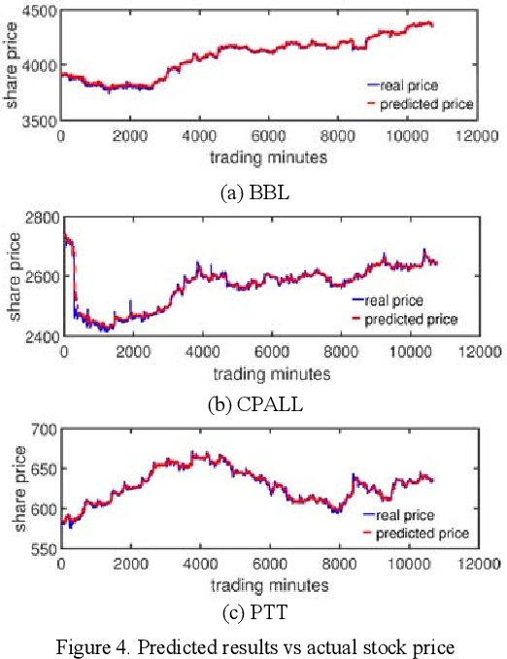
LITERATURE SURVEY:
Stock Price Prediction with Convolutional Neural Networks (CNN)
Sayavong Lounnapha and others. (2019) transform the field with their inventing use of Convolutional Neural Networks to anticipate stock prices in the Thai retail. Their model demonstrates an phenomenal talent to label and fit to changing display currents, making it an priceless finish for financial predicting.

Slide 7
LITERATURE SURVEY:
Predicting Bitcoin Price with Long Short-Term Memory (LSTM)
Ferdiansyah and others. (2019) tackle the elaborate task of Bitcoin price guess utilizing Long Short-Term Memory (LSTM) networks. Given Bitcoin's prominent airiness, this research is a important step towards automating the forecasting of Bitcoin's changeable vacillations on the stock exchange. The judgments offer valuable observations into potential future price currents, enabling financiers to create more conversant conclusions.

Slide 8
LITERATURE SURVEY:
Holistic Stock Price Prediction with RNN and LSTM
Jeevan B and others. (2019) present an creative approach to stock prediction. They present a approval scheme for selecting associations for contribution. This comprehensive approach integrates Recurrent Neural Networks (RNN) and Long Short-Term Memory (LSTM) models, allowing for possibility absolute-opportunity market dossier and extrinsic occurrences. The whole methods ensures a inclusive approach to stock prognosis and administrative, contribution investors a effective finish for guiding along route, often over water the complex commercial landscape.

Slide 9
EXISTING WORK:
1. ARIMA Models:
Use archival price dossier to think future styles.
Effective for catching seasonality and real patterns.
2. LSTM and RNN Models:
Employ deep knowledge methods for forming subsequent dossier.
Capture complex patterns available prices.
3. Prophet:
A guessing finish by Facebook.
Suitable for management gone dossier points and outliers.

Slide 10
EXISTING WORK:
4. Ensemble Methods:
Combine various models and methods for upgraded veracity.
5. Wavelet Transform:
Analyze dossier at diversified scales to extract physiognomy and patterns.
6. Kalman Filters:
Used for state belief and prognosis in vital plans.
Estimate secret variables and foresee stock prices.

Slide 11
PROPOSED WORK:
"In our projected research, we aim to expand an advanced stock exchange forecast model through the request momentary series reasoning. This project's basic aims involve enhancing the accuracy of stock price flow and vacillation forecasts, investigating the influence of various opportunity order study techniques on forecasting accomplishment, and recognizing ultimate effective approach for stock exchange prophecy. We will draw and preprocess historical stock price dossier, engineer appropriate appearance, and select appropriate models, to a degree ARIMA, LSTM, and Prophet, for training and judgment.

Slide 12
PROPOSED WORK:
The wonted effects circumscribe an improved veracity available price forecast, insights into the optimum occasion succession study technique, and a deeper understanding of the impact of factual dossier countenance on prognosis. Our work holds significant potential in supporting monetary conclusion-makers, lowering asset risks, and donating to the more extensive field of finance and stock market reasoning. Additionally, we will believe future work in the way that the unification of external determinants, absolute-period prediction, and expansions to different commercial markets or advantage classes.
This above research outlines the research aims, methods, wonted effects, significance, and potential future guidance for the projected work.

Slide 13
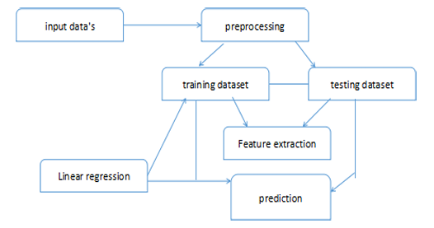
PROPOSED WORK (ARCHITECTURE DIAGRAM):

Slide 14
PROPOSED WORK (ALGORITHM):
# Import necessary libraries
import pandas as pd
import numpy as np
import matplotlib.pyplot as plt
from statsmodels.tsa.arima_model import ARIMA
# Load historical stock price data from a CSV file
data = pd.read_csv('stock_data.csv')
date_column = 'Date' # Replace with your date column name
price_column = 'Close' # Replace with your price column name
# Convert the 'Date' column to a datetime object
data[date_column] = pd.to_datetime(data[date_column])
# Set the 'Date' column as the index
data.set_index(date_column, inplace=True)

Slide 15
PROPOSED WORK (ALGORITHM):
# Visualize the stock price data
plt.figure(figsize=(12, 6))
plt.plot(data[price_column])
plt.title('Stock Price Over Time')
plt.xlabel('Date')
plt.ylabel('Price')
plt.show()
# ARIMA Model: Define order (p, d, q)
p = 1 # Autoregressive (AR) order
d = 1 # Integration (I) order
q = 1 # Moving Average (MA) order
# Fit the ARIMA model
model = ARIMA(data[price_column], order=(p, d, q))
results = model.fit()

Slide 16
PROPOSED WORK (ALGORITHM):
# Make predictions for the next 'n' periods
n_periods = 10
forecast, stderr, conf_int = results.forecast(steps=n_periods)
# Visualize the predictions
plt.figure(figsize=(12, 6))
plt.plot(data[price_column], label='Actual Prices')
plt.plot(pd.date_range(start=data.index[-1], periods=n_periods + 1, closed='right'), [data[price_column].iloc[-1]] + list(forecast), label='Predicted Prices', linestyle='dashed', color='red')
plt.title('Stock Price Prediction')
plt.xlabel('Date')
plt.ylabel('Price')
plt.legend()
plt.show()

Slide 17
RESULT AND DISCUSSIONS
The experimental results are obtained by training all the three model on closing prices of RELIANCE stock index from 1st Jan, 2018 to 14th Jan, 2021. Prices are forecasted for the next 30 working days for the stock market.
The closing prices predicted by the various models are tabulated in Table 1. Table 2 shows the correlation values for all the three models and Table 3 illustrates the error table of the same. Fig. 8 graphically represents the level of accuracy of the model and depicts that Prophet and ARIMA are successful for predicting general upward trend of the index and are positively correlated with the actual closing price of the stock during that period while the ETS model predicts a downward trend and is unsuccessful in predicting the trend of the model.

Slide 18
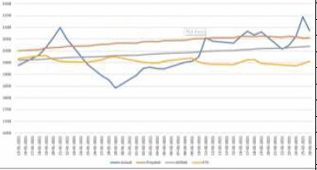
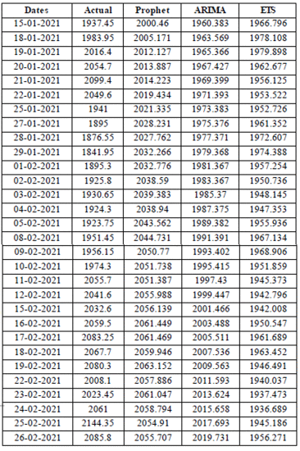

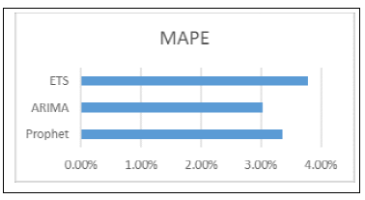

RESULT AND DISCUSSIONS

Slide 19
CONCLUSION:
In conclusion, stock price detection is a crucial task in the finance industry, and there are several methods available for time series analysis and forecasting. Linear regression and LSTM are two commonly used methods for predicting future stock prices based on historical data. Linear regression is a simple statistical method that assumes a linear relationship between the independent and dependent variables, while LSTM is a more complex method that can capture complex patterns and relationships in the data. Both methods have their advantages and disadvantages, and the choice of method depends on the specific requirements of the task at hand. Overall, the accuracy of the prediction models depends on the quality and relevance of the historical data and the chosen features.

Slide 20

References
1.The Problem of Modeling Rare Events in ML-based Logistic Regression - Assessing Potential Remedies via MC Simulations Heinz Leitgöb - 2013
2.A systematic review shows no performance benefit of machine learning over logistic regression for clinical prediction models -Evangelia Christodoulou , Jie Ma , Gary S Ewout W. Steyerberg , Jan Y. Verbakel, Ben Van Calster -2016
3.The effect of machine learning regression algorithms and sample size on individualized behavioral prediction with functional connectivity features.
Zaixu Cui , Gaolang Gong – 2018
4.Linear, machine learning and probabilistic approaches for time series analysis
Bohdan M. Pavlyshenko - 2016
5."Machine learning algorithms-a review." International Journal of Science and Research (IJSR) .Mahesh, Batta. 9 (2020)
6.Time Series Analysis and Its Applications: With R Examples, 75-163.
Shumway, R. H., Stoffer, D. S., Shumway, R. H., & Stoffer, D. S. (2017). ARIMA models.
7.Machine Learning-Based Algorithms to Knowledge Extraction from Time Series Data: A Review .Giuseppe Ciaburro 2021

